Slide 1
These slides display images camera-copied from the .pdfs of papers on color correction. Are displayed the original, the result(s) given by these papers and then our two results (diagonal and non-diagonal). When the colour cloud is really distorted the equalization does an interesting job. In the rare cases where this happens I have also displayed the result of our equalization. The general impression of these experiments is that our method works solidly. In general our both results are competitive and often one of them seems to be the best. This is so much more surprising that our methods are applied without changing any parameter, while these papers often show results of many variants of their own algorithm, with parameters tuned for each image. The second impression is that this kind of comparison is necessary to convince readers. These papers do compare with other methods. Working at home, I was no able to download several papers of interest that I have quoted in the .tex document. Fortunately, there seem to be few competitors whose names return all the time. Gschwind seems to be a precursor on the subject. Then the main groups are Chambah-Besserer, Rizzi-Marini, Lam et al., Nikitenko-Wirth-Trudel, then finally a group around Gabriella Gasparini working specifically on white balance.

Slide 2
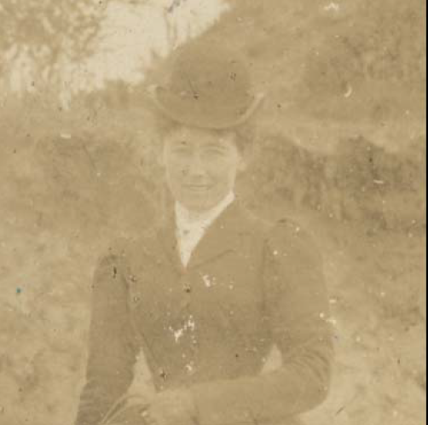
Ramponi-Bruni: Virtual restoration of faded photographic prints

Slide 3
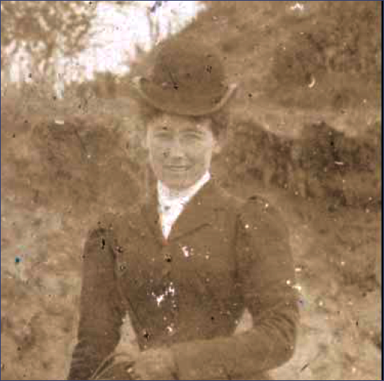
Ramponi-Bruni: Virtual restoration of faded photographic prints: Our first results (diagonal)

Slide 4
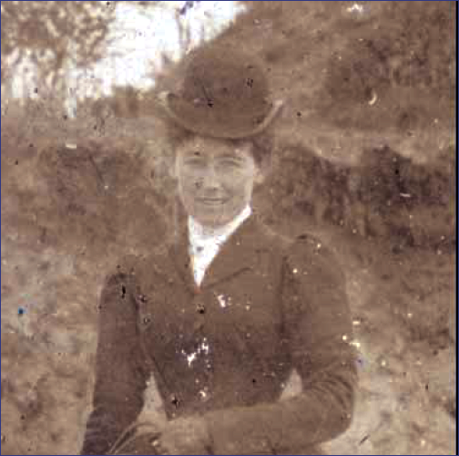
Ramponi-Bruni: Virtual restoration of faded photographic prints : our second result (maximal affine)

Slide 5
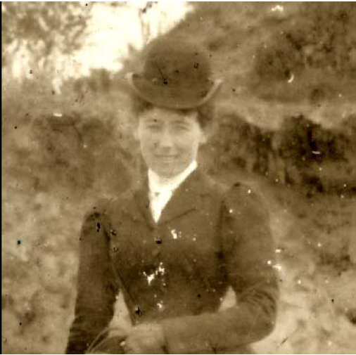
Ramponi-Bruni: Virtual restoration of faded photographic prints: their result (includes spatial filtering)

Slide 6
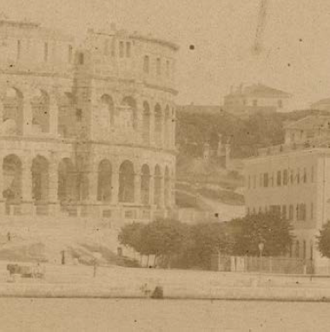
Ramponi-Bruni: Virtual restoration of faded photographic prints

Slide 7
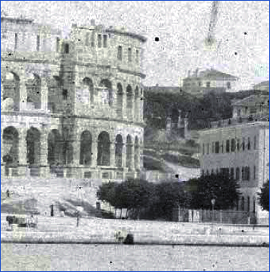
Ramponi-Bruni: Virtual restoration of faded photographic prints: Our first results (diagonal)

Slide 8
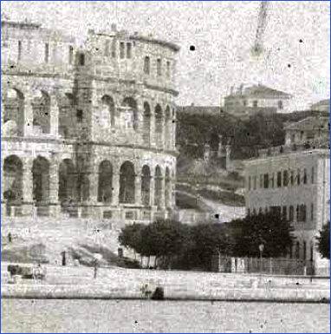
Ramponi-Bruni: Virtual restoration of faded photographic prints : our second result (maximal affine)

Slide 9
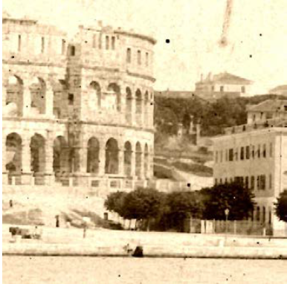
Ramponi-Bruni: Virtual restoration of faded photographic prints: their result (includes spatial filtering on high frequencies)

Slide 10
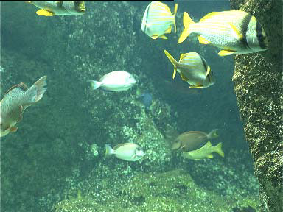
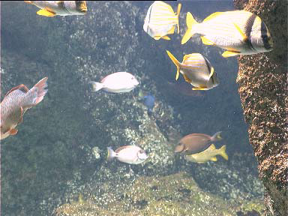

We present in this paper some advances in color restoration of underwater images, especially with regard to the
strong and non uniform color cast which is typical of underwater images. The proposed color correction method is
based on ACE model, an unsupervised color equalization algorithm. ACE is a perceptual approach inspired by some
adaptation mechanisms of the human visual system, in particular lightness constancy and color constancy. A
perceptual approach presents a lot of advantages: it is unsupervised, robust and has local filtering properties, that lead
to more effective results. The restored images give better results when displayed or processed (fish segmentation and
feature extraction).
Underwater Color Constancy: Enhancement of Automatic Live Fish Recognition M. Chambah, D. Semani, A. Renouf, P. Courtellemont, A. Rizzi, original, result of GW, result of GW/WP

Slide 11
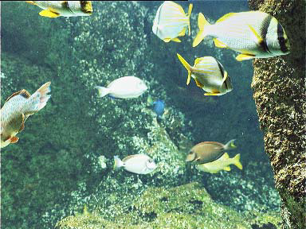
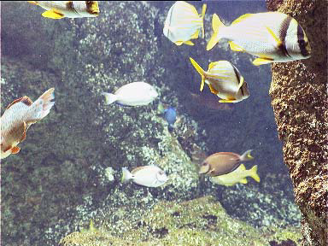
Underwater Color Constancy: Enhancement of Automatic Live Fish Recognition M. Chambah, D. Semani, A. Renouf, P. Courtellemont, A. Rizzi, Original, followed by two variants of ACE

Slide 12
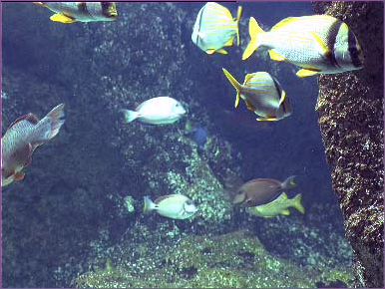
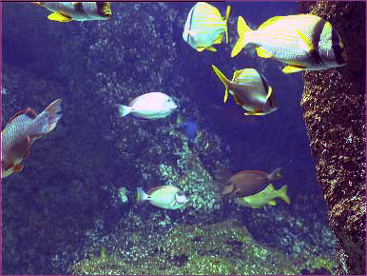
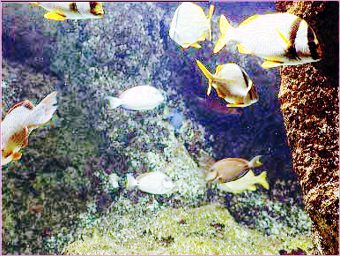
Underwater Color Constancy: Enhancement of Automatic Live Fish Recognition M. Chambah, D. Semani, A. Renouf, P. Courtellemont, A. Rizzi: Original, followed by our three results (diagonal, general, equalization)

Slide 13
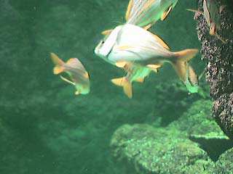
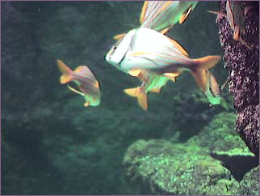
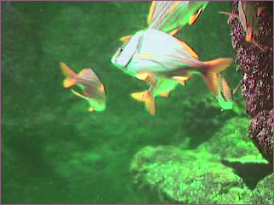
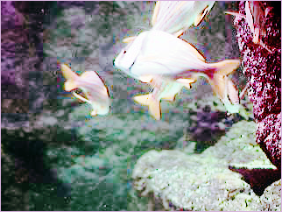
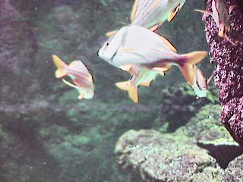
Underwater Color Constancy: Enhancement of Automatic Live Fish Recognition M. Chambah, D. Semani, A. Renouf, P. Courtellemont, A. Rizzi: original and our three results, followed by their best ACE result

Slide 14
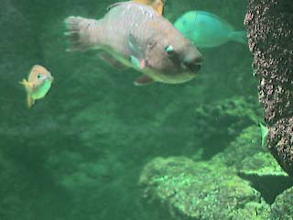
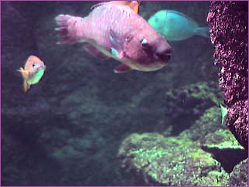
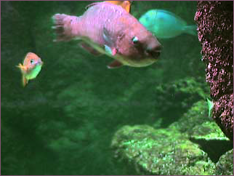
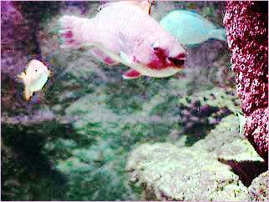
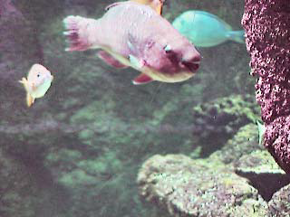
Underwater Color Constancy: Enhancement of Automatic Live Fish Recognition M. Chambah, D. Semani, A. Renouf, P. Courtellemont, A. Rizzi: original and our three results, followed by their best ACE result

Slide 15
Color balancing of digital photos using simple image statistics, Gasparini, F. and Schettini, R.: This .pdf is protected and I was not able to select the (very interesting) images in it. I am sure you can manage to get the images but my computer skills are insufficient.

Slide 16
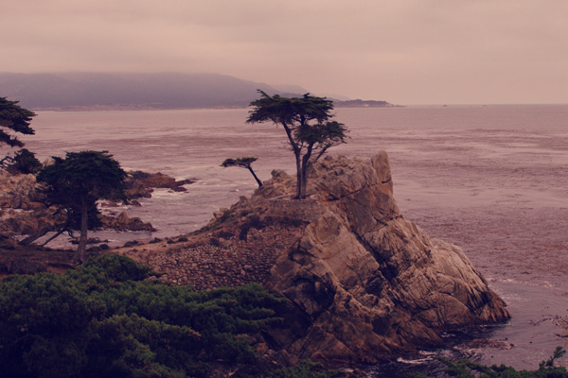
raw image
Combining Gray World and Retinex Theory for
Automatic White Balance in Digital Photography
Edmund Y. Lam

Slide 17
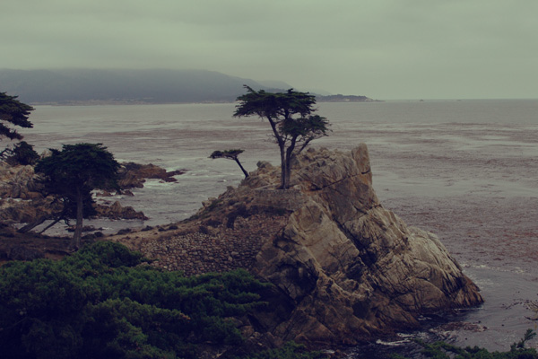
(b) using gray world assumption
Combining Gray World and Retinex Theory for
Automatic White Balance in Digital Photography
Edmund Y. Lam

Slide 18
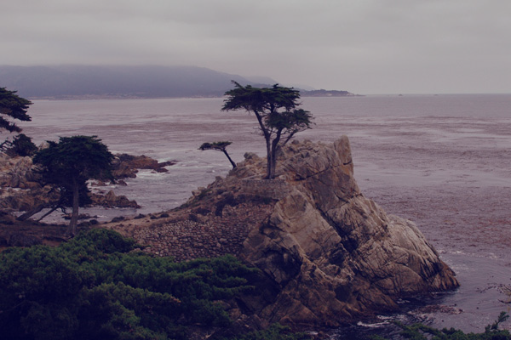
(c) using Retinex theory assumption
Combining Gray World and Retinex Theory for
Automatic White Balance in Digital Photography
Edmund Y. Lam

Slide 19
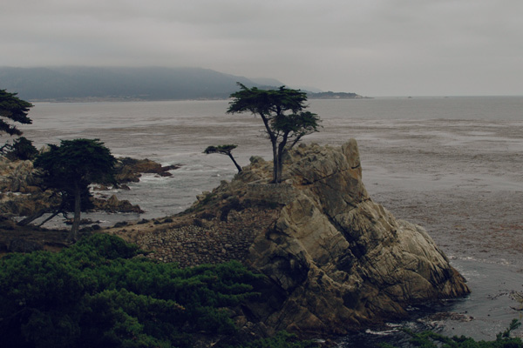
(d) using our quadratic correction
Combining Gray World and Retinex Theory for
Automatic White Balance in Digital Photography
Edmund Y. Lam

Slide 20
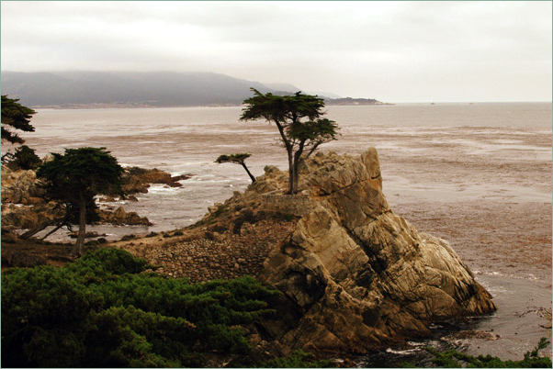
Maximal entropy diagonal

Slide 21
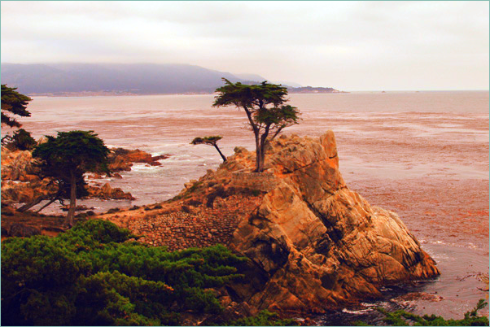
Maximal entropy

Slide 22
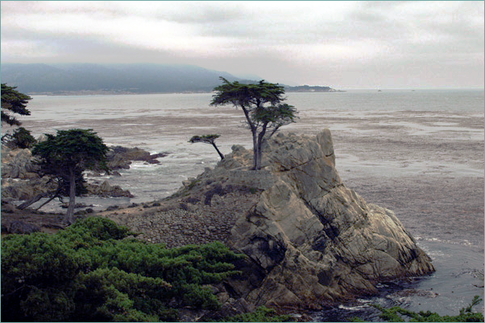
Histogram equalization: this is a typical case where the histogram was distorted and an affine map cannot do a perfect job

Slide 23
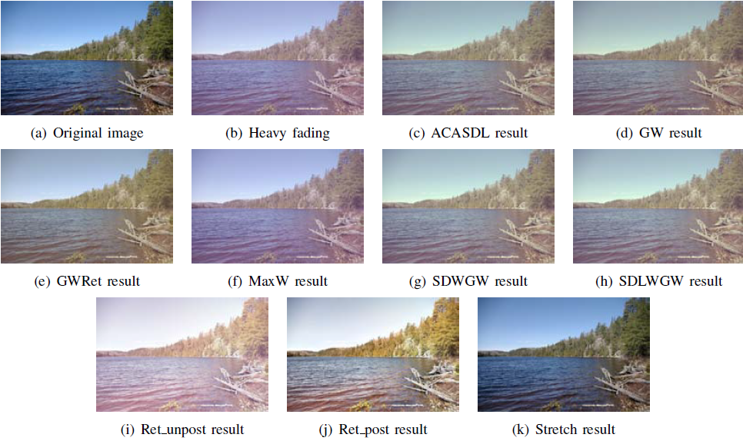
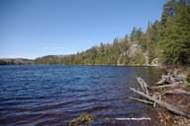
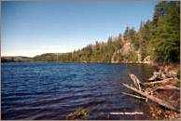
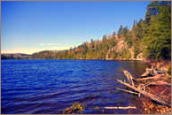
Applicability Of White-Balancing Algorithms to Restoring Faded Colour Slides: An Empirical Evaluation D. Nikitenko, M. Wirth. I have shown their results for 8 different algorithms. Then, original again, and our two results.

Slide 24
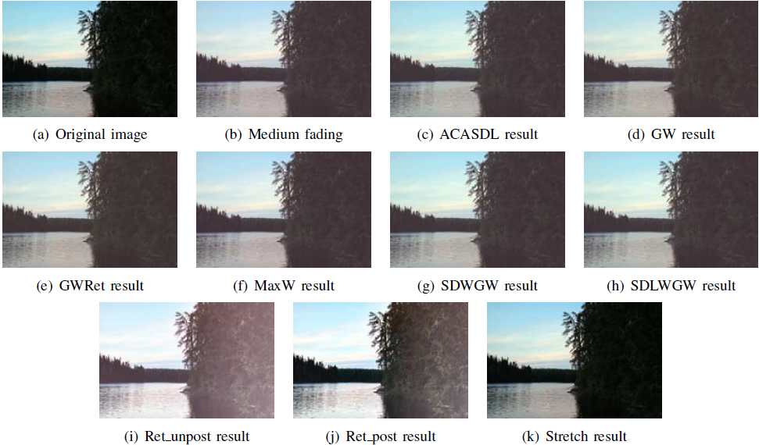
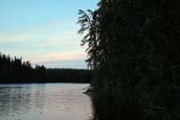
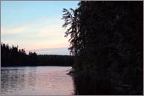
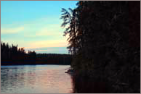
Applicability Of White-Balancing Algorithms to Restoring Faded Colour Slides: An Empirical Evaluation D. Nikitenko, M. Wirth. I have shown their results for 8 different algorithms. Then, original again, and our two results.

Slide 25
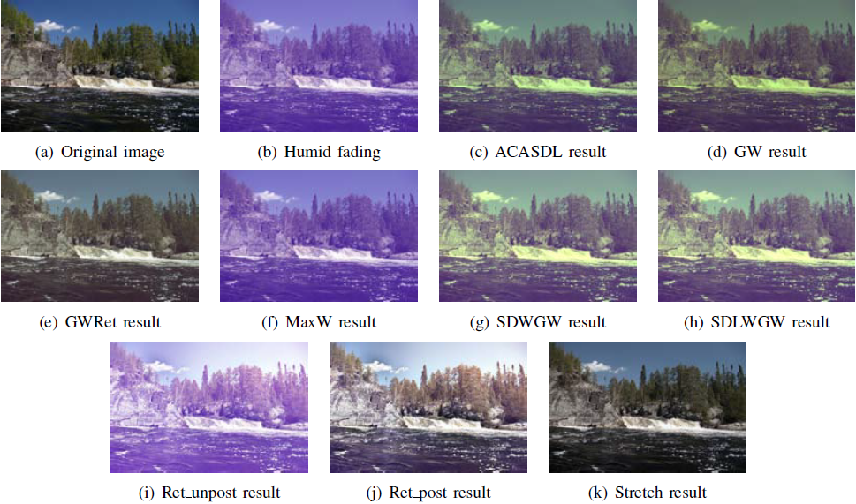
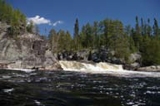
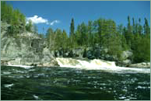
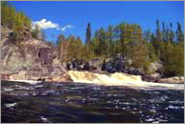
Applicability Of White-Balancing Algorithms to Restoring Faded Colour Slides: An Empirical Evaluation D. Nikitenko, M. Wirth. I have shown their results for 8 different algorithms. Then, original again, and our two results.

Slide 26
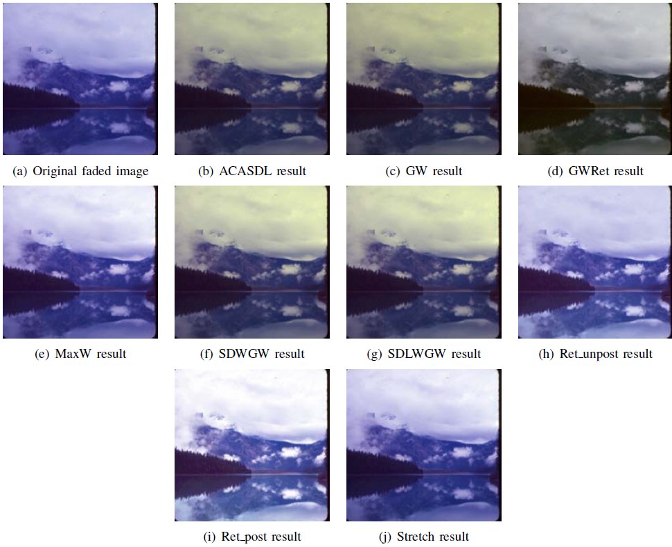
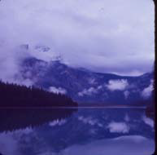
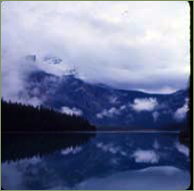
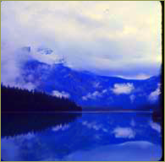
Applicability Of White-Balancing Algorithms to Restoring Faded Colour Slides: An Empirical Evaluation D. Nikitenko, M. Wirth. I have shown their results for 8 different algorithms. Then, original again, and our two results.

Slide 27
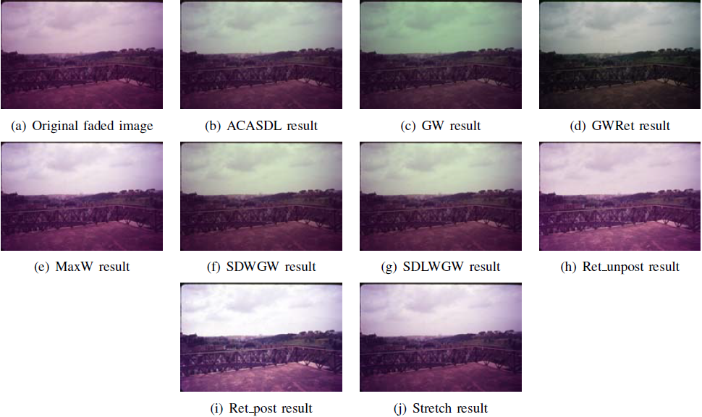
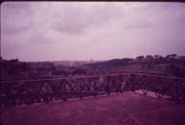


Applicability Of White-Balancing Algorithms to Restoring Faded Colour Slides: An Empirical Evaluation D. Nikitenko, M. Wirth. I have shown their results for 8 different algorithms. Then, original again, and our two results.

Slide 28




Applicability Of White-Balancing Algorithms to Restoring Faded Colour Slides: An Empirical Evaluation D. Nikitenko, M. Wirth. I have shown their results for 8 different algorithms. Then, original again, and our two results.

Slide 29




Original, our two results, followed by the best ACE result. ACE is a very complicated method
and they show many steps of it in the paper. Our first result is very comparable. Our second
one is actually more colorful.
Perceptual approach for unsupervised digital color restoration of cinematographic archives
Majed Chambah, Alessandro Rizzi, Carlo Gatta, Bernard Besserer, Daniele Marini
(They use ACE =Automatic Color Equalization)

Slide 30




Original, our two first results, followed by the best ACE result. ACE is a very complicated method and they show many steps of it in the paper. Our results are obviously better.
Perceptual approach for unsupervised digital color restoration of cinematographic archives
Majed Chambah, Alessandro Rizzi, Carlo Gatta, Bernard Besserer, Daniele Marini
(They use ACE =Automatic Color Equalization)

Slide 31




Original, our two first results, followed by their result
Virtual Restoration of Ancient Chinese Paintings Using Color Contrast Enhancement and
Lacuna Texture Synthesis Soo-Chang Pei, Fellow, IEEE, Yi-Chong Zeng, and Ching-Hua Chang

Slide 32




Virtual Restoration of Ancient Chinese Paintings Using Color Contrast Enhancement and Lacuna Texture Synthesis Soo-Chang Pei, Fellow, IEEE, Yi-Chong Zeng, and Ching-Hua Chang Color contrast enhancement based on saturation and de-saturation is performed in the u v Y color space, to change the saturation value in the chromaticity diagram, and adaptive histogram equalization then is adopted to adjust the luminance component.
Original, our two results, and the result proposed in the paper

Slide 33





DIGITAL COLOR RESTORATION OF FADED MOTION PICTURES
Majed CHAMBAH and Bernard BESSERER:
Original, their best result, and our three results (the last is histogram equalization). The initial data and their restored have not the same resolution. In their result they have specified by hand five colors. Notice that equalization yields a very similar result to their manual complex method.) Their method specifies five colors in some well chosen locations and then finds the best affine map. See next slide.

Slide 34

DIGITAL COLOR RESTORATION OF FADED MOTION PICTURES
Majed CHAMBAH and Bernard BESSERER: Their method specifies five colors in some well chosen locations and then finds the best affine map. Thus it is very similar to ours but linear and manual.

Slide 35

Color Restoration Techniques for Faded Colors of Old Photos, Printings and Paintings Ayman M. T. Ahmed

Slide 36

Color Restoration Techniques for Faded Colors of Old Photos, Printings and Paintings Ayman M. T. Ahmed (their result)

Slide 37

Color Restoration Techniques for Faded Colors of Old Photos, Printings and Paintings Ayman M. T. Ahmed (their second result, supposedly better)

Slide 38

Color Restoration Techniques for Faded Colors of Old Photos, Printings and Paintings Ayman M. T. Ahmed (our first result): it is good but applied to the .pdf and there are JPEG artifacts in the sky. It would be better to have the originals.

Slide 39

Color Restoration Techniques for Faded Colors of Old Photos, Printings and Paintings Ayman M. T. Ahmed (our second result).

Slide 40

Color Restoration Techniques for Faded Colors of Old Photos, Printings and Paintings Ayman M. T. Ahmed : original

Slide 41

Color Restoration Techniques for Faded Colors of Old Photos, Printings and Paintings Ayman M. T. Ahmed (their result)

Slide 42

Color Restoration Techniques for Faded Colors of Old Photos, Printings and Paintings Ayman M. T. Ahmed (our first result)

Slide 43

Color Restoration Techniques for Faded Colors of Old Photos, Printings and Paintings Ayman M. T. Ahmed (our second result, which fails because the algorithm finds a rotation that sends « black » onto « red ». I think this is a failure of our algorithm that we should correct: we should constrain the points with lowest intensity to go to (0,0,0).)

Slide 44




Unsupervised color film restoration using adaptive color equalization A. Rizzi, C. Gatta, C. Slanzi, G. Ciocca, R. Schettini: Original, their best result, our results

Slide 45




Unsupervised color film restoration using adaptive color equalization A. Rizzi, C. Gatta, C. Slanzi, G. Ciocca, R. Schettini: Original, their best result (SLOPE=5), our results

Slide 46



Unsupervised color film restoration using adaptive color equalization A. Rizzi, C. Gatta, C. Slanzi, G. Ciocca, R. Schettini: Original, from Nosferatu (it is a grey movie), our results (they show no decent result)

Slide 47




Unsupervised color film restoration using adaptive color equalization A. Rizzi, C. Gatta, C. Slanzi, G. Ciocca, R. Schettini: Original, their best result (they try many variantes, SLOPE, KOG, combinations of both..., our results

Slide 48


Unsupervised color film restoration using adaptive color equalization A. Rizzi, C. Gatta, C. Slanzi, G. Ciocca, R. Schettini: Original, their best result, our diagonal result, and the histogram equalization. This is a clear case where the histogram is distorted and only the histogram equalization makes it straight. It is clear that we could have a distortion detector for such monochromatic images.

Slide 49




Unsupervised color film restoration using adaptive color equalization A. Rizzi, C. Gatta, C. Slanzi, G. Ciocca, R. Schettini: Original, their result with SLOPE =20, our results

Slide 50




Unsupervised color film restoration using adaptive color equalization A. Rizzi, C. Gatta, C. Slanzi, G. Ciocca, R. Schettini: Original, their result, our results

Slide 51




Unsupervised color film restoration using adaptive color equalization A. Rizzi, C. Gatta, C. Slanzi, G. Ciocca, R. Schettini: Original, their result, our results

Slide 52




Unsupervised color film restoration using adaptive color equalization A. Rizzi, C. Gatta, C. Slanzi, G. Ciocca, R. Schettini: Original, their result, our results

